Slide 1
DTF CONSTRUCTION MONITORING

Slide 2
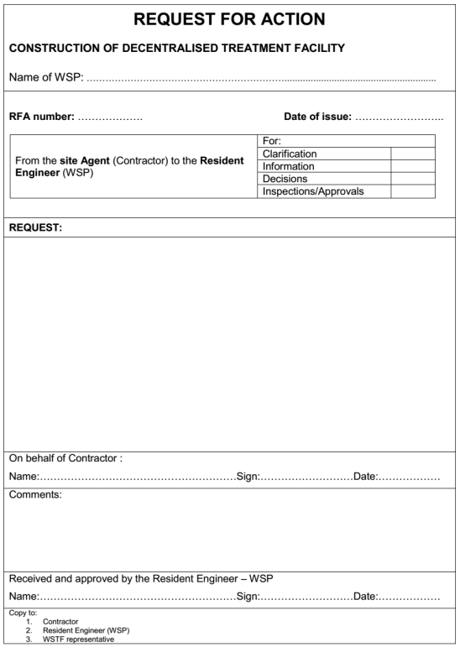
REQUEST FOR ACTION
When: Every time a new major task is to be started
What is it about: Communication from the Contractor to the WSP – request for approval or acknowledgment of a new action
Who prepares: The Site Agent
Who approves: The Resident Engineer

Slide 3
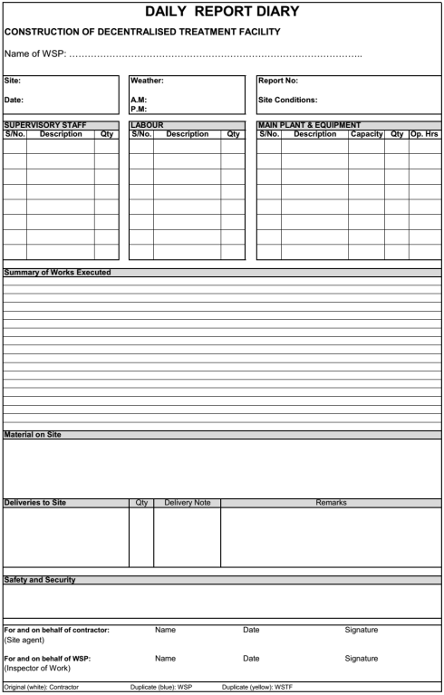
DAILY REPORT DIARY
When: Every day of the construction
What is it about: Reporting of the work being undertaken on a daily basis
Who prepares: The Site Agent
Who approves: The Inspector of Work

Slide 4
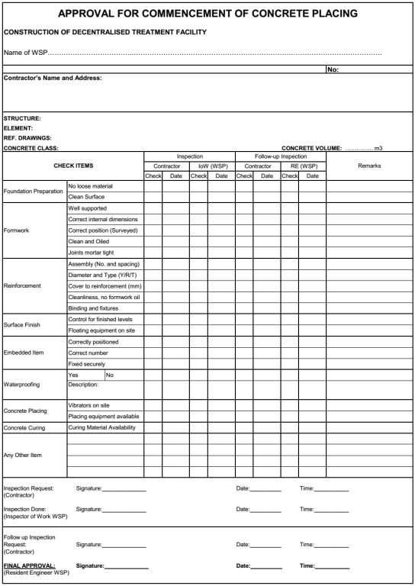
APPROVAL FOR COMMENCEMENT OF CONCRETE PLACING
When: Every time concrete is to be placed
What is it about: Inspection of the concrete placement for approval
Who requests: The Contractor
Who inspects: The Inspector of Work and Resident Engineer
Who approves: The Resident Engineer

Slide 5
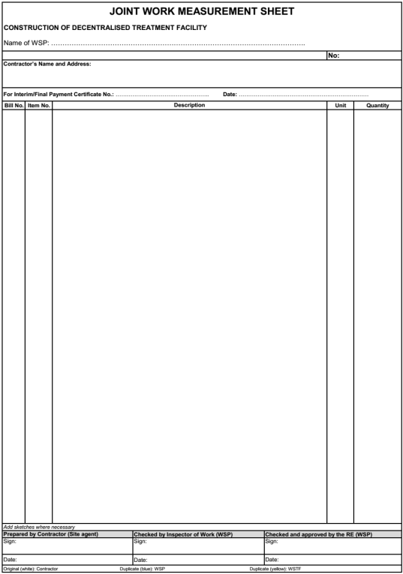
JOINT WORK MEASUREMENT
When: Every week (at least)
What is it about: Measuring the actual material used to compare with the contractual BoQ
Who prepares: The Site Agent
Who checks: The Inspector of Work
Who approves: The Resident Engineer

Slide 6
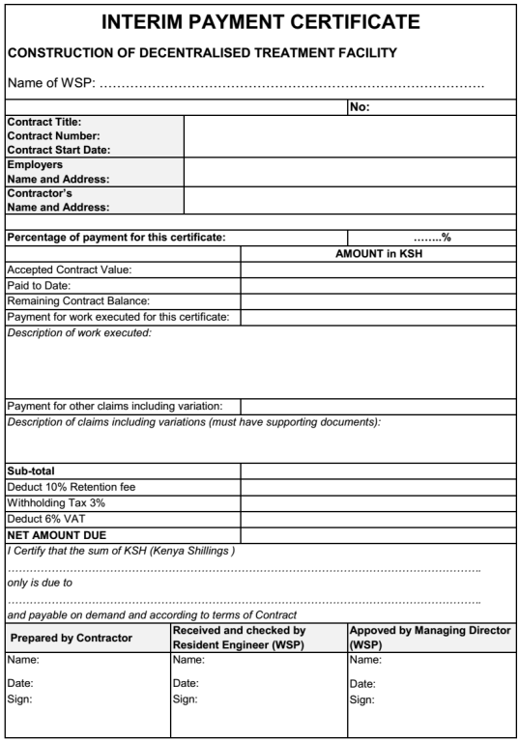
INTERIM PAYMENT CERTIFICATE
When: After the agreed % of the work that has been completed
What is it about: Document for the payment of the work done. Two IPC in total
Who prepares: The Contractor
Who checks: The Resident Engineer
Who approves: The Managing Director

Slide 7
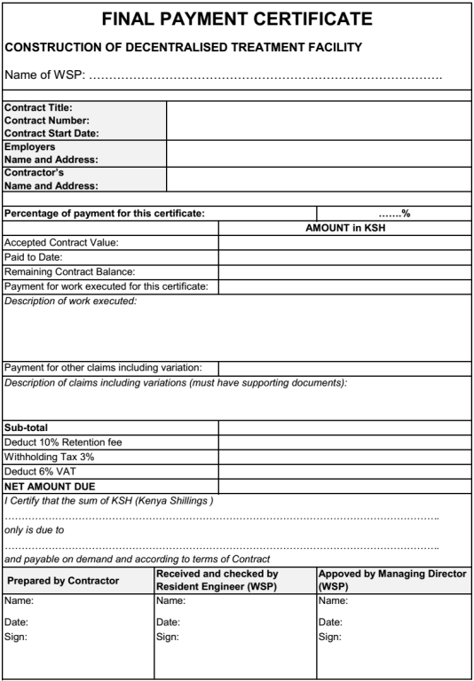
FINAL PAYMENT CERTIFICATE
When: After the substantial completion of the DTF, once the certificate of substantial completion has been issued
What is it about: Document for the last payment of the work done
Who prepares: The Contractor
Who checks: The Resident Engineer
Who approves: The Managing Director

Slide 8
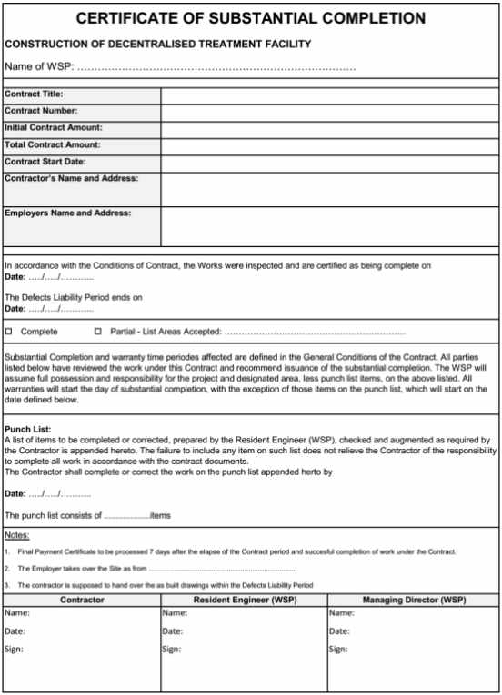
CERTIFICATE OF SUBSTANTIAL COMPLETION
When: After the substantial completion of the DTF
What is it about: Certify that the DTF is substantially completed stating the liability period and the list of remaining items to be completed or corrected
Who prepares: The Resident Engineer
Who approves: The Managing Director and the Contractor

Slide 9
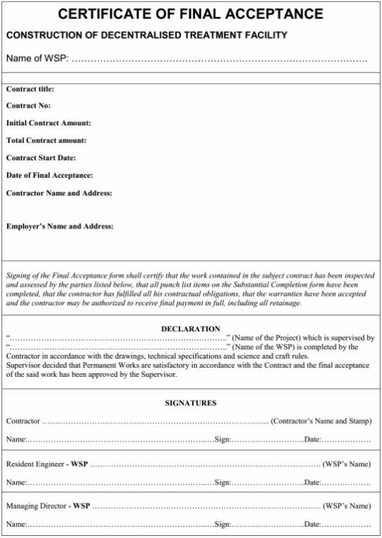
CERTIFICATE OF FINAL ACCEPTANCE
When: After the liability period when the DTF is completed
What is it about: Certify that the DTF is completed for the official hand-over of the site to the WSP
Who prepares: The Resident Engineer
Who approves: The Managing Director and the Contractor

Slide 10
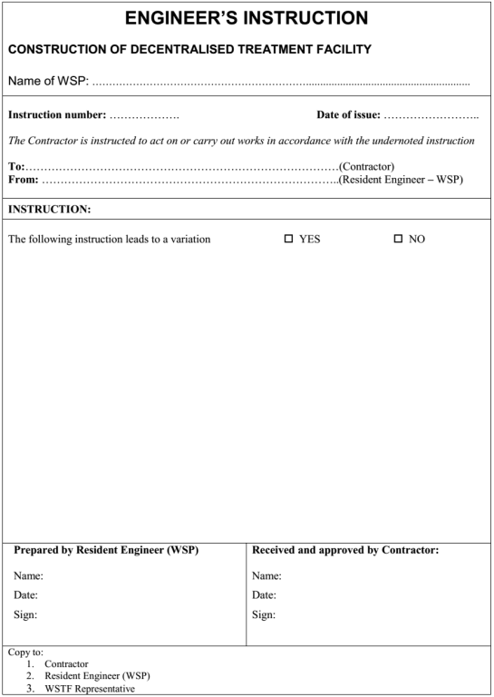
ENGINEER’S INSTRUCTION
When: Every time the WSP needs to give instruction to the Contractor when changes occur
What is it about: Detailed description of the instruction indicating whether variations are involved
Who prepares: The Resident Engineer
Who approves: The Contractor

Slide 11
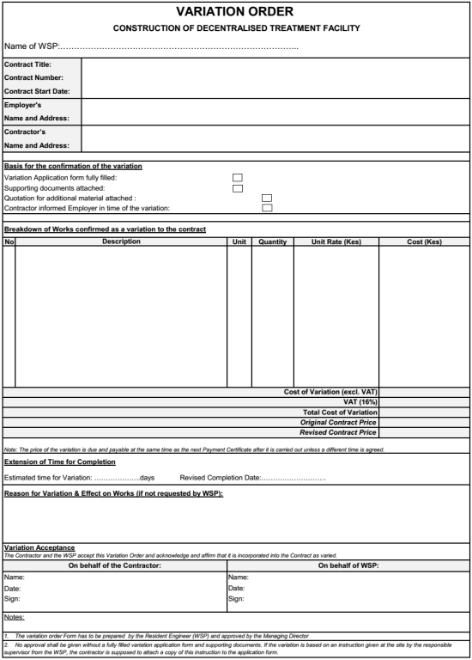
VARIATION ORDER
When: When a variation has been agreed between the Contractor and the WSP
What is it about: Basis for the confirmation of the variation: breakdown of the varied work with calculation of incurred costs
Who prepares: The Contractor (in agreement with the Resident Engineer)
Who approves: The Managing Director

Slide 12
LIST OF CONSTRUCTION MONITORING FORMS
Contractor Side
WSP Side
No | Form | Prepared by | Received, checked and approved by
01 | Request for Action | Site Agent | Resident Engineer
02 | Daily Report Diary | Site Agent | Inspector of Work
03 | Monthly report | Resident Engineer | Managing Director
04 | Approval for commencement of concrete placing | Site Agent | Inspector of Work and Resident Engineer
05 | Joint Measurement sheet | Site Agent | Resident Engineer
06 | Interim Payment Certificate | Contractor | Resident Engineer and Managing Director
07 | Final Payment Certificate | Contractor | Resident Engineer and Managing Director
08 | Certificate of Substantial Completion | Resident Engineer | Managing Director and Contractor
09 | Certificate of Final Acceptance | Resident Engineer | Managing Director and Contractor
10 | Engineer Instruction Form | Resident Engineer | Contractor
11 | Variation Order Form | Contractor and Resident Engineer | Managing Director

Slide 13
WSTF INVOLVMENT
Legend
No | Form
01 | Request for Action
02 | Daily Report Diary
03 | Monthly report
04 | Approval for commencement of concrete placing
05 | Joint Measurement sheet
06 | Interim Payment Certificate
07 | Final Payment Certificate
08 | Certificate of Substantial Completion
09 | Certificate of Final Acceptance
10 | Engineer Instruction Form
11 | Variation Order Form
Copy to send to WSTF for approval (sending of the disbursement)
Copies to attach to the main document

